Slide 1
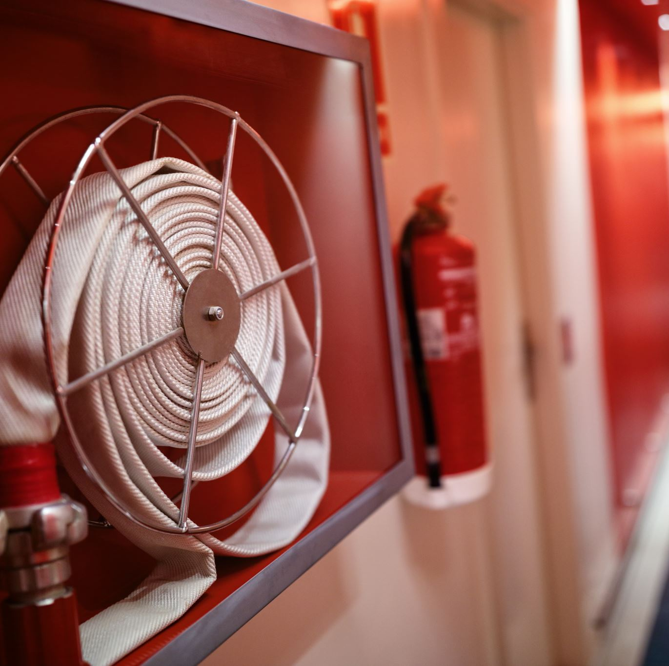
Columbus Fire and Rescue
By Abhinav Myadala

Slide 2
Incident Trend Over Time
Incident Over Time | 2022 | 2023 | 2024
Weekday with Highest Incidents | Thursday | Monday | Monday
Day of Month with Highest Incidents | 24 Day of Month | 4 Day of Month | 2 Day of Month
Month with Highest Incidents | July | August | January
Year Totals | 31,217 | 30,469 | 31,395

Slide 3
Top 20 Incident Types
111- Building Fire
113 - Cooking Fire , Confined to Container
118 - Trash or rubbish fire, contained
131- Passenger vehicle fire
150 - Outside rubbish fire, Other
151 - Outside Rubbish, trash or waste fire
321 - EMS Call , Excluding Vehicle Accident with Injury
322 - Motor Vehicle Accident with injuries
324 - Motor vehicle Accident with no injuries
440 - Electrical wiring / Equipment problem, other
531 - Smoke or odor removal
550 - Public Service Assistance, other
600 - Good Intent Call , Other
611 - Dispatched and cancelled enroute
651 - Smoke scare, Odor of smoke
700 - False Alarm or false call, Other
735 - Alarm system Sounded due to malfunction
740 - Unintentional Transmission of alarm ,other
743 - Smoke Detector Activation, no fire- unintentional
745 - Alarm System Activation, not fire-unintentional

Slide 4
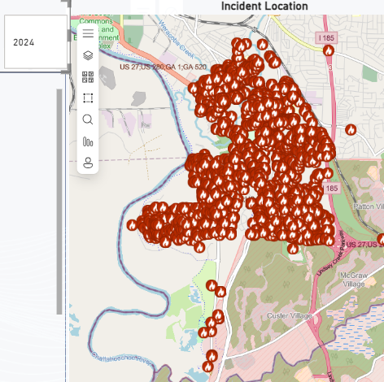
High Risk Areas
The high-risk areas change based on the location of the stations. For example, by looking at the incidents reported by Station 10, you can determine that the high-risk area is Benning Hills.

